Slide 1
Efficient algorithms for finding a longest common increasing subsequence
Wun-Tat Chan · Yong Zhang · Stanley P. Y. Fung · Deshi Ye · Hong Zhu
Journal of Combinatorial Optimization, Vol. 13, pp. 277–288, 2007
Date: Oct. 24, 2007
Introducer: Chung-Han Chiang

Slide 2
Abstract
We study the problem of finding a longest common increasing subsequence (LCIS) of multiple sequences of numbers. The LCIS problem is a fundamental issue in various application areas, including the whole genome alignment. In this paper we give an efficient algorithm to find the LCIS of two sequences in O(min(r logl , nl +r ) log log n+Sort(n)) time where n is the length of each sequence and r is the number of ordered pairs of positions at which the two sequences match, is the length of the LCIS, and Sort(n) is the time to sort n numbers. For m sequences where m ≥ 3, we find the LCIS in O(min(mr², r logl log^{m} r ) + m·Sort(n)) time where r is the total number of m-tuples of positions at which the m sequences match. The previous results find the LCIS of two sequences in O(n²) and O(nl log log n+Sort(n)) time. Our algorithm is faster when r is relatively small, e.g., for r < min(n²/(logl log log n), nl/ logl ).

Slide 3
Definition
Dominate: We call a match (i ‘, j ‘) dominates another match (i, j ) or that (i ‘, j ‘) is a dominating match of (i, j) if ai ‘< ai and i ‘< i and j ‘< j .
A :2134
B :2431
2 4 3 1
a₁ = 2, a₁ = (1, 1)
a₂ = 1, a₂ = (4, 2)
a₃ = 3, a₃ = (3, 3)
a₄ = 4, a₄ = (2, 4)
a₁ dominates a₃
a₁ dominates a₄
2 1 3 4
2
 |  |  | 1
 |  | 3
 | 4

Slide 4
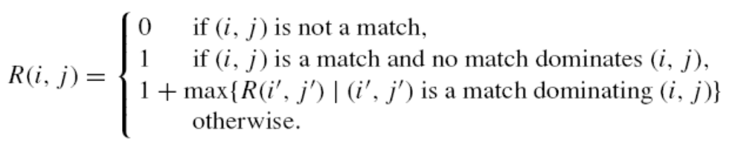
R(i , j)
2 4 3 1
a₁ = 2, R(a₁)= 1
a₂ = 1, R(a₂)= 1
(No match dominates a₂)
a₃ = 5, R(a₃)= 2
a₄ = 4, R(a₄)= 2
2 1 3 4
2
 |  |  | 1
 |  | 3
 | 4
It is easy to see that the length of the LCIS of A and B is = max{R(i, j )}.

Slide 5
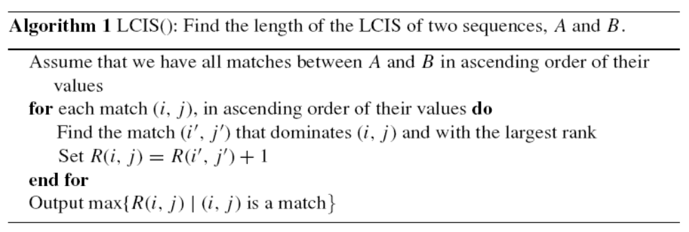
Algorithms

Slide 6
In this section we give two efficient implementations of Algorithm LCIS(), which run in O (r logl loglogn + Sort(n)) and O ((nl +r ) loglogn + Sort(n)) time.
M be the set of matches whose ranks have been computed so far. There are at most l (disjoint) partitions of M, namely M¹, M²,.., M^{l}, where M^{k} contains the matches with rank k

Slide 7
t in M^{k}
dominate
A in M^{k}
A in M^{k+1}

Slide 8
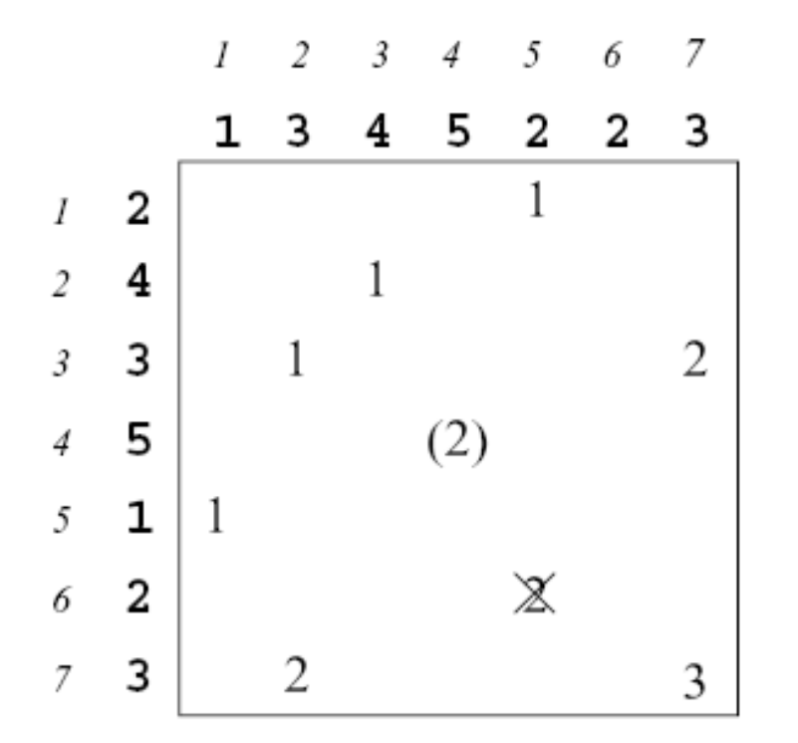
Critical match: A match (i, j ) in a partition is called a critical match if there is no match
(i ‘, j ‘) of the same partition with i ‘ ≤ i and j ‘ ≤ j.
Critical match
Non-critical match

Slide 9
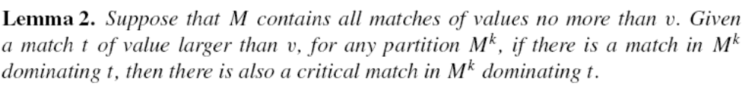
t’’(i’’, j’’) in M^{k}
t‘(i’, j’) in M^{k}
t(i, j) in M^{k+1}

Slide 10
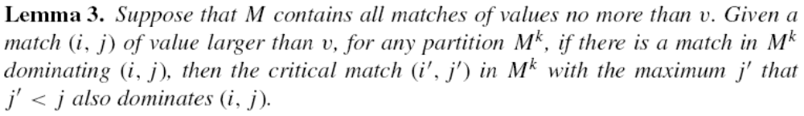
t*(i*, j*) in M^{k}
t‘(i’, j’) in M^{k}
t(i, j) in M^{k+1}

Slide 11

t(i, j)
t*(i*, j*) in M^{k}
t‘(i’, j’) in M^{k}
Non – critical match

Slide 12
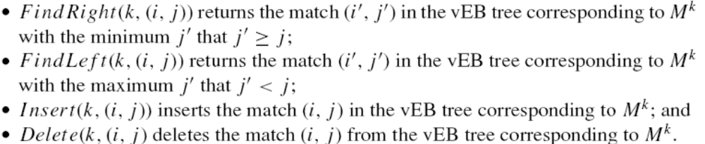
For each of M^{k} with 1 ≤ k ≤ l, we employ the data structure van Emde Boas (vEB) tree (van Emde Boas, 1975) to store the critical matches in M^{k}

Slide 13
A：35274816→(3,1) (5,2) (2,3) (7,4) (4,5) (8,6) (1,7) (6,8)
sort x→ (1,7) (2,3) (3,1) (4,5) (5,2) (6,8) (7,4) (8,6)
B：51724863→(5,1) (1,2) (7,3) (2,4) (4,5) (8,6) (6,7) (3,8)
sort x→ (1,2) (2,4) (3,8) (4,5) (5,1) (6,7) (7,3) (8,6)

Slide 14
3 5 2 7 4 8 1 6
5 1 7 2 4 8 6 3
 | 5
 |  |  |  |  |  | 1
 |  |  | 7
 |  | 2
 |  |  |  | 4
 |  |  |  |  | 8
 |  |  |  |  |  |  | 6
3
Sort match number→
1(7 , 2)
2(3 , 4)
3(1 , 8)
4(5 , 5)
5(2 , 1)
6(8 , 7)
7(4 , 3)
8(6 , 6)

Slide 15
T₁ ： empty
T₂ ： empty
T₃ ： empty
T₄ ： empty
T₅ ： empty
T₆ ： empty
T₇ ： empty
T₈ ： empty
T₁ ： 1(7,2)
T₂ ： empty
T₃ ： empty
T₄ ： empty
T₅ ： empty
T₆ ： empty
T₇ ： empty
T₈ ： empty
T₁ ： 2(3,4)
T₂ ： empty
T₃ ： empty
T₄ ： empty
T₅ ： empty
T₆ ： empty
T₇ ： empty
T₈ ： empty
1(7 , 2)
2(3 , 4)

Slide 16
T₁ ： 2(3,4)
T₂ ： empty
T₃ ： empty
T₄ ： empty
T₅ ： empty
T₆ ： empty
T₇ ： empty
T₈ ： empty
T₁ ： 2(3,4)
T₂ ： 4(5,5)
T₃ ： empty
T₄ ： empty
T₅ ： empty
T₆ ： empty
T₇ ： empty
T₈ ： empty
T₁ ： 2(3,4) dominate T₂
4(5 , 5)
T₁ ： 2(3,4)
T₂ ： 4(5,5)
T₃ ： 6(8,7)
T₄ ： empty
T₅ ： empty
T₆ ： empty
T₇ ： empty
T₈ ： empty
Follows the rule

Slide 17
Suppose R(i, j) = k
Case1：i’ ≦ i, j’ ≦ j
t’(i’, j’) in M^{k}
Case2：i’ > i, j’ > j
Case3：match value (i’ , j’) < match value (i , j)
t(i, j) in M^{k}

Slide 18
It takes O(Sort(n) + r ) time to sort the two sequences A and B and identify the matches between A and B in ascending order of their values.
(2) It takes O(logl loglog n) time to find the largest rank dominating match of a given match in the binary search because the function FindLeft is called O(logl ) times and there are at most non-empty vEB trees. Hence it takes O(r logl log log n) time to find the ranks of all matches.
(3) Each match can be inserted and deleted at most once from a vEB tree. Each of these operations takes O(log log n) time, and hence it takes O(r loglog n) time for all matches.
Altogether, it takes O(r logl loglogn+Sort(n)) time.

